Slide 1

Disease Prediction Using Machine Learning
Predicting diseases based on symptoms.

Slide 2


Our Team
Pulkit Malik
Sanskar Sengar
Faculty Details
E23CSEU0677
E23CSEU0667
Dr. Sanchali Das

Slide 3


Problem Statement
Accurate disease prediction is crucial.
1
Early Detection
2
Personalized Treatment
3
Resource Allocation
Improve patient outcomes.
Optimize care strategies.
Efficient healthcare system.

Slide 4
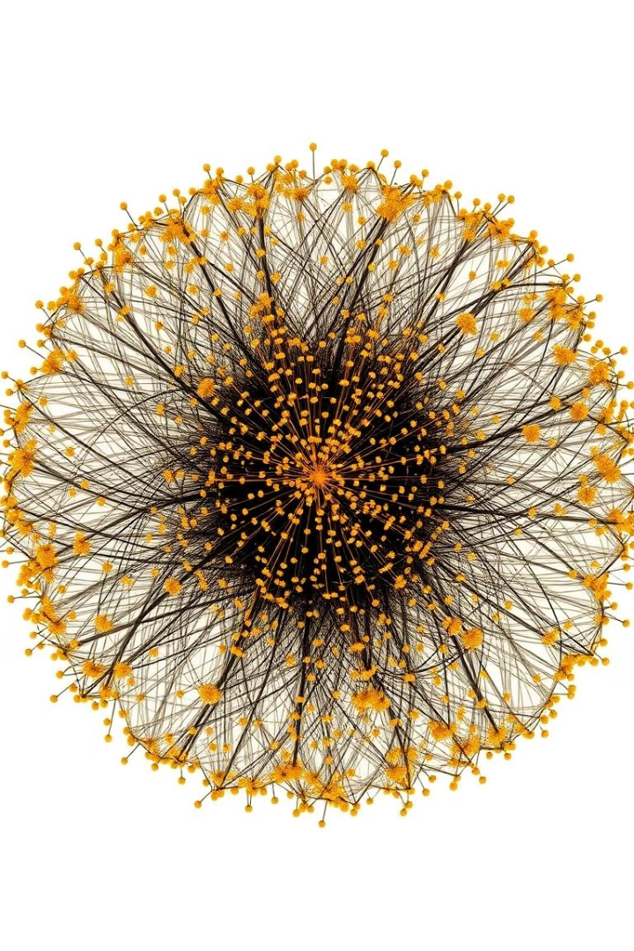
Dataset and Features
The dataset contains 132 features.
Symptom Features
Disease Prognosis
Patient Demographics
Disease Classification

Slide 5
Machine Learning Models
Multiple models were used.
SVC
Naive Bayes
Random Forest
Support Vector Classification
Probabilistic classification
Ensemble learning method

Slide 6
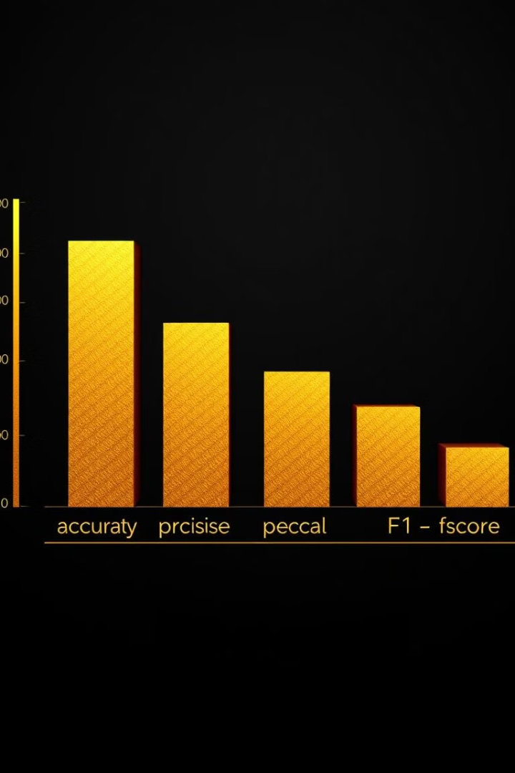
Evaluation Metrics
Model performance was evaluated.
1
Accuracy
2
Confusion Matrix
Correct predictions over total.
True positives, true negatives, false positives, false negatives.

Slide 7




Key Findings
Models achieved high accuracy.
Outlier Detection
Data Preprocessing
Model Comparison
Z-score and IQR methods used.
Enhanced model performance.
Random Forest outperformed others.

Slide 8

Future Work
Continued research is needed.
Real-Time Prediction
Deep Learning
Integrate models into clinical workflow.
Explore more complex models.

Slide 9

Conclusion
Disease prediction with machine learning.
Potential to revolutionize healthcare.

